Slide 1
Programming Languages
Language Translation,
Lexical and Syntax analysis

Slide 2
Language Translation
The goal is to convert a program into an executable form and then to evaluate it.
Interpretation - simple but slow
Optimizing Compilers - complex
Process may be divided into two parts
  Analysis of input program
  Synthesis of executable program
Number of passes of a compiler
  One pass (Pascal) linear order of elaboration
  Multiple pass
    analyze source program
    optimize
    generate code

Slide 3
Program structure
Syntax:
Structural arrangement of a program
BNF (Backus Naur Form or context free grammars):
  a useful notation for describing syntax
Semantics:
Static semantics - Semantics determined at compile time:
  var A: integer; // Type & storage for A)
  int B[10]; // Type & storage for B)
  //Function Attributes
  float myProc(float x;float y){int z; ...}
Dynamic semantics – the meanings of expressions, statements and program units as the program runs
  int denom = 0;
  int numerator = 5;
  int result = numerator / denom;

Slide 4
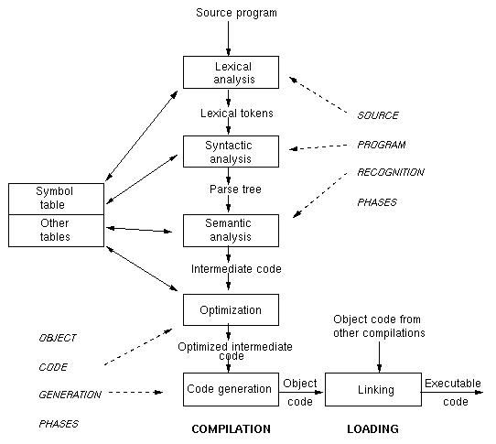
Stages in translating a program

Slide 5
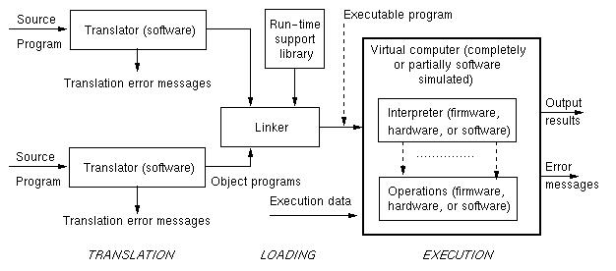
Executing a Program

Slide 6
Major stages of Language Translation
Lexical analysis (Scanning):
  Breaking a program into primitive components, called tokens (identifiers, numbers, keywords, etc.)
  Regular grammars and finite state automata are formal models of this.
Syntactic analysis (Parsing):
  Creating a syntax tree of the program.
  Context free or BNF grammars and pushdown automata are formal models of this.
Symbol table creation: Stores information about declared objects (identifiers, method names, ...)

Slide 7
Major stages (cont)
Semantic analysis:
  Understanding the relationship among the tokens in the program.
Optimization:
  Rewriting some representation in the translation process to improve efficiency in execution.
Code generation:
  Converting the parsed program into an executable form.

Slide 8
Lexical Analysis
The process of identifying the separate lexemes (words) of the input:
  Identifiers
    ItemCount
    InputFile
  Keywords
    Begin, End, While
  Numeric items
    1235, 1.234, 3.45E16
  Strings
    “First Name”
  Delimiters
    (), []
  Operators
    +, -, := >=
The process is simplified by removing comments, line breaks, etc.

Slide 9
Syntactic Analysis - Parsing
Takes a flat unstructured sequence of tokens and produces a structured intermediate form that can be more effectively understood and manipulated (a parse tree)
Identifies larger program structures (statements, declarations, expressions, etc) using the lexical items (tokens) produced by the tokenizer.
Checks and verifies that a program is syntactically correct.
Syntax checks:
  Are all commas, periods, and keywords in the correct place and order
  This is handled by a context free grammar
Syntactic analysis alternates with Semantic analysis.
1. Identify a syntactic unit
2. Analyze semantics of the unit.

Slide 10
Parse Trees
Program
Var J:Integer;
Begin
J := J + 1;
End.
Context Free grammars can handle the tree structured portions of the parse
The context sensitive portions are handled by using a Symbol Table to link declarations to their uses
Scope rules allow binding of names to their declarations
Context Free
Context sensitive
<program>
Program
<declaration>
Begin
<stmnt>
End
.
Var
<id>
:
<type>
;
<id>
:=
<exp>
;
J
Integer
J
J
+
1

Slide 11
Compilers
In the 1950s, compilers were considered notoriously difficult to write (Fortran took 18 staff years - Backus)
Analysis-Synthesis Model of Compilation
  Analysis - breaks up the source program into constituent parts and creates an intermediate representation of the source program
  Synthesis - constructs the desired target program from the intermediate representation
Several types of compilers exist:
  Single-pass
  Multi-pass
  Debugging
  Optimizing

Slide 12
Example Analysis of a Program
Consider this statement:
  position := initial + rate * 60
Lexical Analysis :
Tokenizing produces the following:
  1. The identifier position
  2. The assignment symbol
  3. The identifier initial
  4. The plus sign
  5. The identifier rate
  6. The multiplication sign
  7. The number 60

Slide 13
Analysis of a Program
Syntax Analysis – building the parse tree:
assignment
statement
:=
identifier
expression
position
+
expression
expression
identifier
*
initial
expression
expression
identifier
number
rate
60

Slide 14
Analysis of a Program
A Syntax tree is the typical internal representation of a parse tree:
(what is different about this?)
:=
position
+
initial
*
rate
60

Slide 15
Analysis of a Program
Semantic Analysis - checks the source program for semantic errors and gathers type information. The compiler checks for data types, scope, type coersions, reals used as subscripts, etc.
:=
position
+
initial
*
rate
inttoreal
60

Slide 16
Other Compiler Functions
Symbol Table Management - used to collect essential information about all the identifiers in the program such as
  types
  scope of named entities
  for functions/methods - parameters and types, argument passing method, type returned
Error Detection and Reporting
  Some compilers stop when they encounter the first error, others keep going
  Lexical phase - characters don’t form a token
  Syntax analysis - token stream violates syntax
  Semantic phase - syntactically correct but having no meaning - try to add an array to a procedure

Slide 17
An Example Compilation
position := initial + rate * 60
lexical analyzer
id1 := id2 + id3 * 60
syntax analyzer
:=
id1
+
id2
*
id3
60
semantic analyzer
:=
id1
+
id2
*
id3
inttoreal
60

Slide 18
An Example Compliation
intermediate code generator
temp1 := inttoreal(60)
temp2 := id3 * temp1
temp3 := id2 + temp2
id1 := temp3
code optimizer
temp1 := id3 * 60.0
id1 := id2 + temp1
code generator
MOVF id3, R2
MULF #60.0, R2
MOVF id2, R1
ADDF R2, R1
MOVF R1, id1

Slide 19
An Example Compliation
The Analysis Phase
  Lexical Analysis reads the characters and groups them into streams of tokens. Lexemes are the character sequence forming a token.
  Syntax Analysis imposes a hierarchical structure represented as a tree
  Semantic Analysis - typing
Intermediate Code Generation - may be thought of as a program for an abstract machine. Important properties:
  easy to produce
  easy to translate into target program
Code Optimizaton
  many optimizations are possible
  most of compile time is spent here in optimizing compilers
Code Generation
  normally consists of re-locatable machine or assembly code
  assigning variables to registers is a critical operation

Slide 20
General Parsing Algorithms
Knuth in 1965 developed a class of grammars called LR(K) [Left-to-right parsing with K symbol lookahead]
  This class of algorithm can be used to parse all BNF grammars recognized by deterministic PDA.
  they are distinguished one from another by the number of input symbols they must look ahead.
  LR(1) parsers look ahead one symbol.
    Most parsers are LR(1) parsers
Lookahead principle - peeking at future symbols without actually reading them in order to resolve non-determinism in a state change.

Slide 21
Top-down vs Bottom Up Parsers
1. Top-down parsers - start by putting the start symbol on the stack and growing the parse tree from root node to leaf nodes
LL Parsers - left-to right scanning and a leftmost derivation of the sentence.
Predictive Parsers – this class of parser must predict which rewrite rule to apply next based upon the lookahead.
LL(k) parsers - there is a hierarchy of LL parsers distinguished by the number of input symbols they must look ahead. K is an integer that indicates how far they must look ahead.
Recursive descent parsing is a top-down approach.
2. Bottom-up Parsers - transfers symbols from input to the stack until the upper-most symbols (called a handle) correspond to the RHS of a single non-terminal found on the LHS of a rule. At this point the single non-terminal is substituted. Subsequent symbols are pushed and substituted until the start symbol only remains on the stack.
LR Parsers - parse with left-to-right scanning, getting a rightmost derivation. Avoids many of the problems of the predictive parsers.
LR(k) parsers - look ahead K symbols
Shift and Reduce operations - shift symbols onto the stack, reduce by substituting a LHS symbol.

Slide 22
Recursive descent parsing
A simple top-down parsing algorithm
Can be used to parse context-free grammars
Implemented from the BNF representation for a grammar
The non-terminals of the grammar become procedures
Assume that:
  Variable lookahead always contains the type of the next token being read from input.
  Function getchar reads in a character
  At points in the program we might need to ungetch() which puts back a character at which we peeked.

Slide 23
Recursive descent parsing
Consider the BNF grammar for simple assignment statements involving arithmetic expressions:
<assignment statement> ::= <variable> = <expression>
<expression> ::= <term> <add_op><term> | <term>
<term> ::= <primary><mult_op><primary> | <primary>
<primary> ::= <variable> | <number> | (<expression>)
<variable> ::= <identifier> | <identifier> [<subscript list>]
<subscript list> ::= <expression> | <expression>, <subscript list>
<add_op> ::= + | -
<mult_op> ::= * | /
<identifier> ::=
number ::=

Slide 24
Recursive descent parsing
Each nonterminal of the grammar becomes a function in the parser:
  Assignment_Statement
  Expression
  Term
  Primary
  Variable
  Subscript_List
  Number
  Identifier
Assume that Identifier and Number are functions that recognize numbers and identifiers.

Slide 25
Generic LL Parse Algorithm
createEmptyStack()
push(S) // the start rule
read(Symbol)
while stack-not-empty do
case top-of-stack
terminal:
if top-of-stack = Symbol // match
pop stack
read(Symbol)
else
error
nonterminal: // push lower-level RHS
if table[top-of-stack,Symbol] != error
pop stack
push table[top-of-stack,Symbol]
else
error
end case
end while
if Symbol not end-of-input marker
error

Slide 26
Difficulties with top-Down Parsers
Left recursive rules will result in infinite recursions in recursive descent parsers when the program executes a subprogram based upon them.
The parser must be able to predict the rule to apply next on the basis of the first symbol in the RHS. No ambiguity can exist for this prediction to be successful.

Slide 27
Left Recursions
Consider this rule:
  A → Aα | B
A recursive descent parser subprogram would immediately call itself to parse the first item on the RHS, and would just keep doing this.
How about this?
  A → BaA
  B → Ab
Left recursions can be removed by algorithmic process.

Slide 28
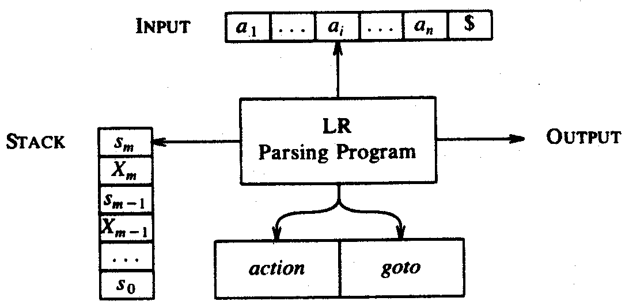
Schematic Form of an LR Parser
The lexical analyzer returns tokens one at a time
A stack is used to store a string of the form s₀X₁s₁X₂s₂…x_{m}S_{m}
  S_{i}: state i
  X_{i}:grammar symbol i

Slide 29
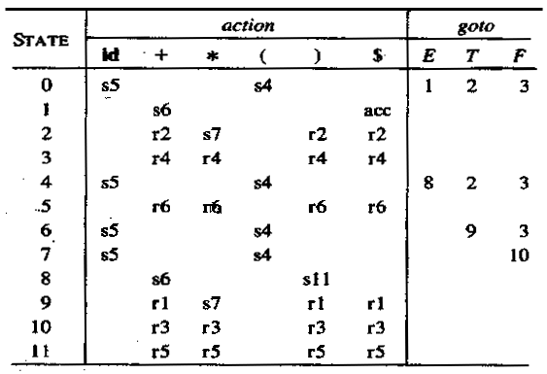
The Parse Table for the Example Grammar

Slide 30
LR PARSE ALGORITHM
s = 0
push(s)
set ip to point to the first symbol in w$
repeat forever begin
let s be the state on top of stack and
a the symbol pointed to by ip;
if action[s,a] = shift s’ then begin
push a then s’ onto stack;
advance ip to the next input symbol;
end
else if action[s,a]=reduce A->B then begin
pop 2*|B| symbols off the stack;
let s’ be the state on top of stack;
push A then goto[s’,A] on top of stack;
output production A->B
end
else if action[s,a] = accept then
return
else
error();
end

Slide 31
LR Parse Example Grammar
Grammar for arithmetic expressions with binary operators + and *
    (1) E → E + T
    (2) E → T
    (3) T → T * F
    (4) T → F
    (5) F → (E)
    (6) F → id

Slide 32
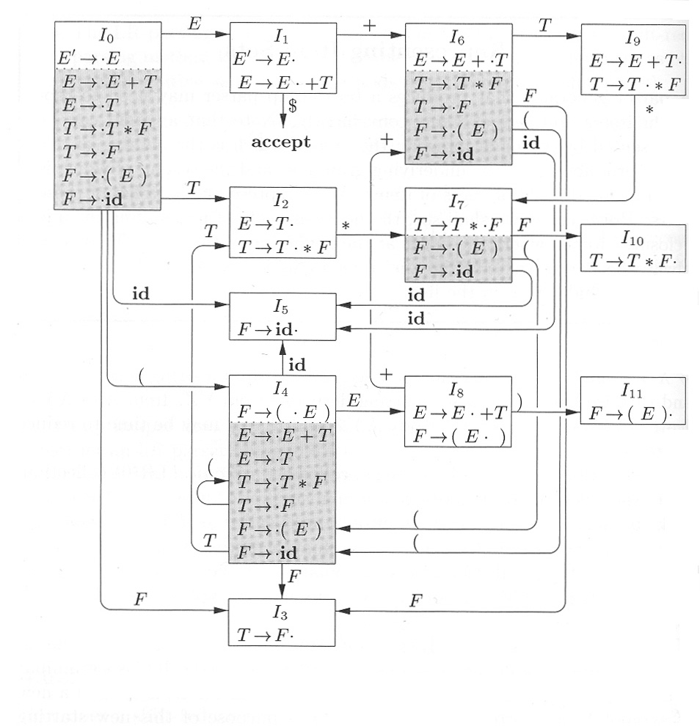
Characteristic Finite State Machine underlying the parse table for the previous grammar

